Slide 1
Final Project Process
My Coca Cola story

Slide 2
The assessment
Your manager has asked for an analysis of your organization's strengths and weaknesses. Your analysis will be forwarded to your CEO to present at a board meeting. Your manager has asked for the following elements in a PowerPoint presentation:
The organization’s objective and a brief description (your CEO is on the road and may not have access to this data).
SWOT analysis: identifying the strengths, weaknesses, opportunities, and threats to your organization
Comparison statistics with similar organization.
Descriptive statistics for a business problem you identified in your SWOT.
Word cloud related to your SWOT (consider searching for articles or data about your company, products, customers, etc)
1 slide with your choice of analysis using a data mining tool
The CEO may not have time to read the content deeply. Your PowerPoint should contain extensive notes to assist the CEO. Include information on the types analytics used, why they are useful, and what the results identify.
Be sure there is an organization that you can compare content to in a meaningful way. Consider examining a similar organization or one with the same scope (NZ to NZ; International to International). You may also consider companies that have accounts your would like to emulate or use as a benchmark.
Include your datasets as an attachment.

Slide 3
Decide on company
I chose Coca Cola because I know a bit about the company from previous work.
I know there are many issues Coca Cola has been dealing with, like:
  Water consumption
  Recycling
  Sugar/corn syrup
  Advertising to children…
Notes:
Comments: Start with something you know or want to learn more about – it makes the project easier if you are interested in the company.
I lived in Georgia (just outside of Atlanta) where Coca Cola is headquartered. Coca Cola execs often came to the university I worked at to discuss issues the company was facing (operations, marketing, etc). I know that Coca Cola was working on recycling water in their plants - sustainability is something of interest. I have been to Coca Cola World (long advertisement, followed by a trip to the tasting room – where they have all of their drinks available for trial), it is a world-wide brand and very visible. I used to drink Coke, but don’t any more. I know I am not the only one (changing market).
If I didn’t know these things, I may have to do additional reading about my company to identify these issues.

Slide 4
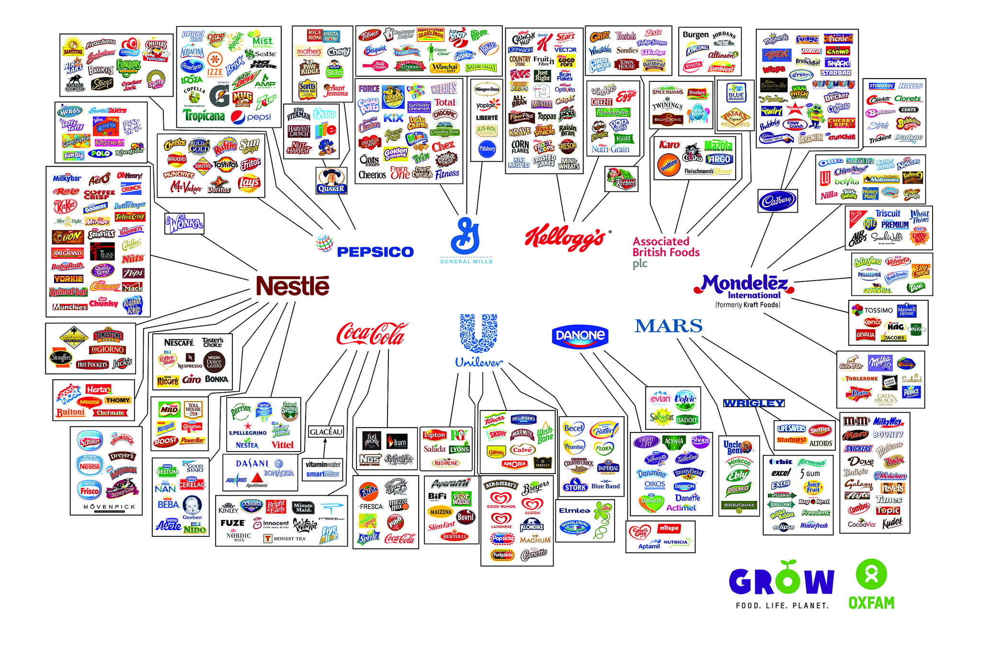
Focus
Notes:
I came across this infographic last week - https://www.oxfamamerica.org/static/media/files/Behind-the-brands-illusion-of-choice-graphic-2048x1351.jpg
I regularly scan business and social/political sources for issues (part of being an informed citizen).
Unfortunately, it is from an article discussing how 10 companies made most of the food we buy (https://www.oxfamamerica.org/explore/stories/these-10-companies-make-a-lot-of-the-food-we-buy-heres-how-we-made-them-better/).
I think I may focus on water, but I am not sure if I want to compare with Pepsico or Nestle right now. I could also try and compare Global brand with NZ. Is there a market Coca-Cola may want to break into or is looking at (I may be able to find that at the website or in a business source)
I do find it interesting that Coca-Cola has not diversified in the same way that Pepsico has. {if you zoom in on the image, coke is the only one of the companies with a single industry}

Slide 5
Organization’s objective and a brief description
Possible sources
  Google
    http://www.coca-colacompany.com/infographic-journey-by-the-numbers
  Coca-colacompany.com
    http://www.coca-colacompany.com/our-company/infographic-coca-cola-at-a-glance
    Our Company -> Mission vision and values
  VUW Library
    Business Source Complete: search “coca cola”
    http://helicon.vuw.ac.nz/login?url=http://search.ebscohost.com/login.aspx?direct=true&db=bth&bquery=%26quot%3bcoca+cola%26quot%3b&type=1&site=ehost-live
      SWOT Analysis 2015 (can mine/extend)
      Articles about water management
      PR Nightmare article
Notes:
There is information about companies in multiple databases (Business Source Complete, ABI/Inform, Newztext…I will identify some of my favorite sights in this document. You can also look at the guide the Commerce Librarian created: http://libguides.victoria.ac.nz/c.php?g=564451 )
On the off chance I would find something interesting, I searched: (coca cola by the numbers) just to see what I would find. I came across Coca-Cola Journey a digital magazine (http://www.coca-colacompany.com/infographic-journey-by-the-numbers). I may find something good
Started working my way through the Coca-Cola company site. Found infographic – can’t copy it, but may mine it for data

Slide 6
Organization’s objective and a brief description
More possible sources
  VUW Library
      ABI/Inform Global: search “coca cola”
        Lots of articles from business sources and trade magazines
      Hoover’s Company Profiles (via ProQuest)
        See not below
        Overview, History, products
          #1 nonalcoholic beverage company
Notes:
Hoover’s (through ProQuest) pulls up every Coca-Cola related company (bottlers, distributors, national HQs, etc. Choose Coca Cola North America, which had a link to TCCC The Coca-Cola Company. This moved me to the Hoover’s interface (colors and URLs change).

Slide 7
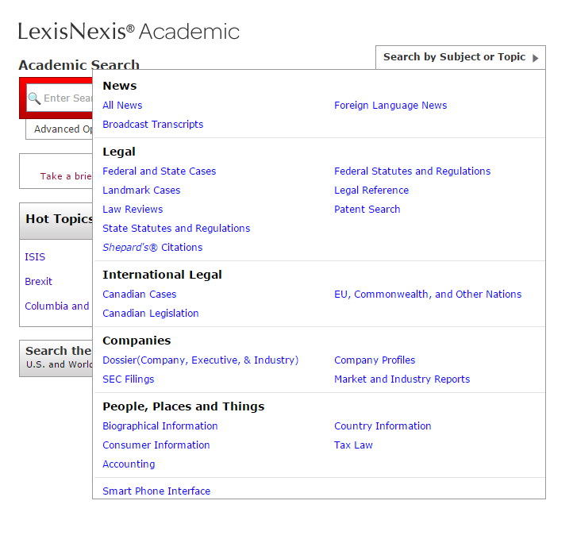
Organization’s objective and a brief description
More possible sources
  VUW Library
    LexisNexis Academic
      Over 6,000 newspapers worldwide
      Company information
      Patent and legal info (depending on your SWOT, could be useful).
  EDGAR: SEC Filings
    Financial reporting to the US Gov.
    https://www.sec.gov/investor/pubs/edgarguide.htm
Notes:
You can search EDGAR online at the sec.gov or through LexisNexisAcademic
Why? Good source of financial data. Annual reports have about 5 years of data in the report (and there are usually 5 years or so of reports available for investors on company websites).

Slide 8
Did you notice…
I choose to go directly to the edatabases using either the guide or the A-Z databases list (http://library.victoria.ac.nz/library-v2/research-and-study-help/databases-az)
Te Waharoa searches wide (multiple databases at once) – and does not focus on what I specifically need.

Slide 9
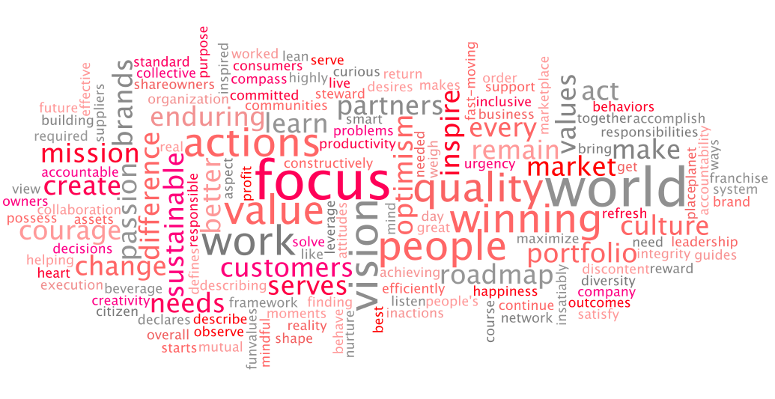
Objectives and Description: Putting together a story and looking for trends
Notes:
Lot’s of information on the mission vision page - http://www.coca-colacompany.com/our-company/mission-vision-values
Sustainability ties to what I was thinking of with water (commodification of water; environment).
At this point, rather than run through R, I am going to create a word cloud using wordle.net (it doesn’t remove stopwords). I may have to work on that…but it is a quick way to check for value. I may come back to this.

Slide 10
Competitors
AMERICAN BEVERAGE CORPORATION
Aquaterra Corporation
Big Heart Pet Brands
BRITVIC PLC
CHIQUITA BRANDS INTERNATIONAL, INC.
CITRUS WORLD, INC.
Clearly Canadian Beverage Corporation
LASSONDE PAPPAS AND COMPANY, INC.
Cott Corporation
Northland Cranberries, Inc.
DANONE
DOLE FOOD COMPANY, INC.
Dr Pepper Snapple Group, Inc.
Faygo Beverages, Inc.
Fiji Water Company, LLC
Fresh Del Monte Produce Inc.
Great Western Juice Company
Hawaiian Springs, LLC
HORNELL BREWING CO., INC.
Izze Beverage Co.
Impulse Energy USA Corp.
JAMBA, INC.
JONES SODA CO.
KIRIN HOLDINGS COMPANY, LIMITED
Industries Lassonde Inc
Leading Brands, Inc
THE MONARCH BEVERAGE COMPANY INC
MONDELEZ INTERNATIONAL, INC.
Mountain Valley Spring Company, LLC
Naked Juice Co. of Glendora, Inc.
NATIONAL BEVERAGE CORP.
Naumes, Inc.
Nestlé S.A.
Ocean Spray Cranberries, Inc.
Old Orchard Brands LLC
PEPSICO, INC.
PERNOD RICARD
Red Bull GmbH
Silver Springs Citrus, Inc.
South Beach Beverage Company, Inc.
Southern Gardens Citrus Holding Corporation
Sun-Rype Products Ltd
Sunny Delight Beverage Co
SUNTORY HOLDINGS LIMITED
Tree Top, Inc.
True Drinks Holdings, Inc.
Unilever
WELCH FOODS INC., A COOPERATIVE
THE JOLT COMPANY INC
Notes:
Hoover’s lists out everyone from beverage companies, to conglomerates like Mondelez (Kraft), to fruit companies.

Slide 11
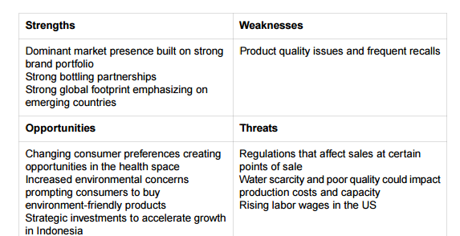
SWOT
Brainstorm
Read overviews in Hoover’s or other company profiles
Review other swots
Scan docs to see where future focus is located
Notes:
Hoover’s Overview points:
7 main segments based on geography for the most part
Sell “finished beverages” (63% of sales in 2015) and “beverage concentrates and syrups”
55% of sales outside of US [wow! I would have thought that would be higher]
“…one of the most recognizable and valuable brands”
Spent $4billion on advertising in 2015 [could be interesting comparison [2015, $4b; 2014, $3.5b; 2013$3.26b]
“..sales have fallen with changing consumer tastes in developed markets”
A lot to unpack here:
“The soft-drink maker's sales fell 4% to $44.3 billion during 2015 with sales falling in every segment and region except for North America (where it sold more bottled water and teas), mostly due to the unfavorable impact of foreign exchange rates. ”
Decrease sales in general
Increase in water and tea sales in North America
Exchange rate can be an issue
Key markets; India, China, Africa (new bottling plant in Myanmar 2013)
2014 Teamed with Keurig (10 year agreement)
Purchased 16% of Monster Beverage Corp.
Health concerns: noncarbonated products: fruit juices, sports and energy drinks, and bottled water and tea beverages.
Business Source Complete: http://helicon.vuw.ac.nz/login?url=http://search.ebscohost.com/login.aspx?direct=true&db=bth&AN=108385604&site=ehost-live
[image above]
Cocacolacompany.com – scanning press releases, company statements, articles, etc.
- diversity – (company articles) – among “top 50 companies for diversity’
- 100% rating from the Human Rights Campaign for Corporate Equality Index
- OK: Here is something I didn’t expect to find (not important for this project, but hmmm I wonder what map they used? USSR?): The Coca-Cola Russia team had a stylized map of Russia created as part of its Christmas campaign. The agency that created the map later made changes without our knowledge or approval. We, as a company, do not take political positions unrelated to our business, and we apologize for the post, which we have removed (http://www.coca-colacompany.com/press-center/company-statements/statement-on-coca-cola-russia-holiday-greeting)
***Company and its Bottling Partners Meet 2020 Water Replenishment Goal Five Years Early; Intend to Maintain Water Stewardship Performance as Business Continues to Grow: http://www.coca-colacompany.com/press-center/press-releases/coca-cola-is-the-first-fortune-500-company-to-replenish-all-the-water-it-uses-globally

Slide 12
Comparisons
Taken by water and sustainablility:
http://www.coca-colacompany.com/water-stewardship-replenish-report
I think I am going to compare with pepsico
- I am going to focus on water OR sustainability (may look at both).
Pepsico and Coca-Cola have sustainability reports. Will compare in with word clouds
Why focus on sustainability? May need another slide
Notes:
So – I can compare stats or recycling or employees, just about anything, but I am interested in sustainability initiatives. I am going to search a business database to see how they compare on issues and adoption
In Business Source Complete, I found 83 articles on Coca-Cola and Sustainability.
In that set was: http://helicon.vuw.ac.nz/login?url=http://search.ebscohost.com/login.aspx?direct=true&db=bth&AN=101617918&site=ehost-live
2015 Sustainability Trends
Maybe I can use this to review data from Coca-Cola and Pepsico:
Risk-based thinking
Supplier sustainability assessments
Water scarcity
Reporting (well, they both have reports)
I have downloaded sustainability reports for Coca-Cola, Pepsico, and Nestle (just in case). I have used an online tool to convert the PDFs for Coke and Pepsi into txt files.
https://www.coca-colacompany.com/content/dam/journey/us/en/private/fileassets/pdf/2015/07/2014-2015-sustainability-report.15_080415.pdf
http://www.pepsico.com/docs/album/sustainability-reporting/pep_csr14_sus_overview.pdf
[both sites have sustainability pages too]
http://www.nestle.com/asset-library/Documents/Library/Documents/Corporate_Social_Responsibility/Nestle-in-Society-Summary-Report-2015-EN.pdf

Slide 13
Time so far…
I have worked on and off for about 5 hours to get to this point.
  One both ppts.
On-and-off means:
  I answered the phone
  Looked at emails
  Talked to people
  Went for a snack
Notes:
I do recommend keeping track of your process. I know that you are balancing multiple deadlines, so adding notes and a few links to a document or a ppt can save you a lot of backtracking in the future.
I am also getting APA citations or creating them along the way. EBSCO’s citations for the Annual reports were not standard. I looked up the appropriate format and edited it so I don’t have to later.

